Slide 1

Introduction to Data Analytics
ITE 5201
Lecture7-Hypothesis Testing

Slide 2
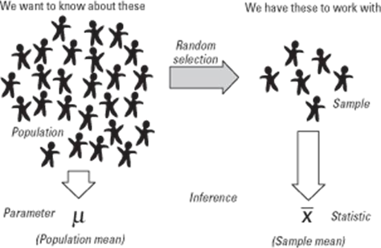

Populations and samples
Taking a sample from a population
Sample data ‘represents’ the whole population
Copyright © 2018 Pearson Education, Inc. All Rights Reserved.

Slide 3


Point estimation
Sample data is used to estimate parameters of a population
Statistics are calculated using sample data.
Parameters are the characteristics of population data
sample mean
Population mean
μ
estimates
Sample SD
Population SD
σ
Copyright © 2018 Pearson Education, Inc. All Rights Reserved.

Slide 4
Hypothesis testing
A Hypothesis is a guess or assumption about something which can be tested to see if it is correct or not.
A good hypothesis statement can be tested by
Experiments.
Surveys.
Copyright © 2018 Pearson Education, Inc. All Rights Reserved.

Slide 5
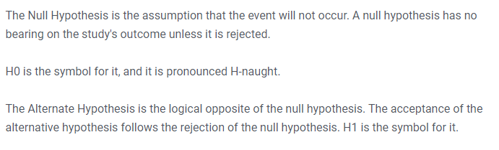
Hypothesis testing
Notes:
Let's understand this with an example.
A sanitizer manufacturer claims that its product kills 95 percent of germs on average.
To put this company's claim to the test, create a null and alternate hypothesis.
H0 (Null Hypothesis): Average = 95%.
Alternative Hypothesis (H1): The average is less than 95%.

Slide 6

Example of “The Court Case”?
Members of a jury have to decide whether a person is guilty or innocent based on evidence
Null: The person is innocent
Alternative: The person is not innocent (i.e. guilty)
The null can only be rejected if there is enough evidence to doubt it.
i.e. the jury can only convict if there is beyond reasonable doubt for the null of innocence
They do not know whether the person is really guilty or innocent so they may make a mistake
Copyright © 2018 Pearson Education, Inc. All Rights Reserved.

Slide 7
Types of Errors
Type 1 Error
Type 2 Error
Occurs when we reject a true
null hypothesis.
It is denotes by α.
Occurs when we reject a
false null hypothesis.
It is denotes by β.
Copyright © 2018 Pearson Education, Inc. All Rights Reserved.

Slide 8
Significance Level
The significance level, also denoted as alpha or α, is the probability of rejecting the
null hypothesis when it is true.
A significance level of 0.05 indicates a 5% risk of concluding that a difference exists
when there is no actual difference.
Copyright © 2018 Pearson Education, Inc. All Rights Reserved.

Slide 9
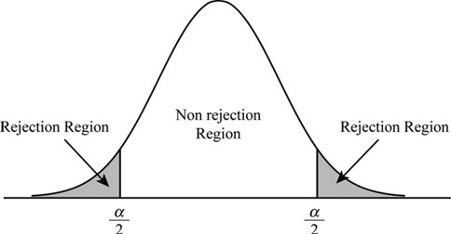
Significance Level
Copyright © 2018 Pearson Education, Inc. All Rights Reserved.

Slide 10
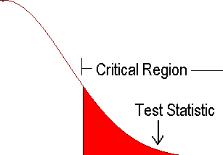
Critical Region
A critical region is an area which gives us statistical significance to reject or fail
to reject our claim.
Copyright © 2018 Pearson Education, Inc. All Rights Reserved.

Slide 11
P-value
P-value is the probability that the null hypothesis is correct.
P-value stands in support of the null hypothesis.
P-value is between 0 and 1.
If P-value < significance level, then we reject the null hypothesis.
If P-value > significance level, then we fail to reject the null hypothesis.
Copyright © 2018 Pearson Education, Inc. All Rights Reserved.

Slide 12
t-Distribution
Student’s T distribution is a type of probability distribution which is similar to
normal distribution with its bell shaped curve but has heavier tails.
It occurs when the sample size is less than 30 and population standard deviation is
unknown.
Copyright © 2018 Pearson Education, Inc. All Rights Reserved.

Slide 13
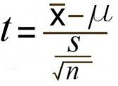
One Sample T test
When comparing the mean values of two samples that specific characteristics
may connect, a t-test is performed to see if there exists a substantial difference.
One Sample T-Test is a statistical procedure used to examine or compare the
mean of our sample data to already known population mean.
Formula used for One sample T-test
Copyright © 2018 Pearson Education, Inc. All Rights Reserved.

Slide 14
Degree of Freedom
It is the number of values in the final calculation of a statistic that are free to
vary.
We calculate the degree of freedom by the formula “n-1”
where n is the sample size.
If the sample size=20,
then degree of freedom = 20-1 = 19
Copyright © 2018 Pearson Education, Inc. All Rights Reserved.

Slide 15
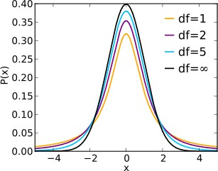
Relationship to normal
As the sample size gets big, the t-distribution matches the normal distribution
Normal curve
_{www.statstutor.ac.u}C_{k}opyright © 2018 Pearson Education, Inc. All Rights Reserved.

Slide 16

Two Sample T Test
Two Sample T-Test is a statistical procedure used to examine or compare the
The Independent Samples T-Test is also a parametric test. The Independent t Test
is another name for this test.
mean of two separate samples.
Formula for Two Sample Test
Copyright © 2018 Pearson Education, Inc. All Rights Reserved.

Slide 17

Paired Sample T Test
The dependent samples t-test is another name for the paired samples t-test.
An illustration of this would be taking a person's blood pressure before and
after a specific medication, condition, or period.
Paired Sample T-Test is a statistical procedure for examining or comparing the
means of two samples.
It has the situation of before and after.
Formula for Paired Sample Test
Copyright © 2018 Pearson Education, Inc. All Rights Reserved.

Slide 18
T Test vs Z Test
A z-test is a statistical test to determine whether two population means are
A z-statistic, also known as a z-score, measures how many standard deviations a
score resulting from a z-test is either above or under the mean population.
different when the variances are known.
T-Test :
sample size is less than 30
population standard deviation is unknown.
Z-Test:
sample size is greater than 30
population standard deviation is
known.
Copyright © 2018 Pearson Education, Inc. All Rights Reserved.

Slide 19
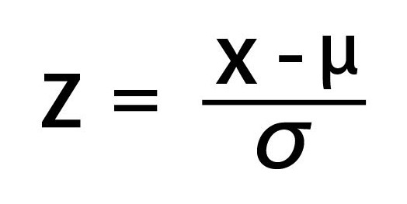
One Sample Z Test
The One Sample z-test is used to test whether the mean of a population is greater
than, less than or not equal to a specific value.
x bar is the is the sample mean.
μ is the population mean.
σ is the population standard deviation.
Copyright © 2018 Pearson Education, Inc. All Rights Reserved.

Slide 20
One Sample Z-Test
A z-table is a mathematical table that allows us to know the percentage of values
below a z-score value in a standard normal standard deviation.
z-score is positive, then p-value = 1-z-score
z-score is negative. then p-value = z-score
p-value < significance level, then we reject the null hypothesis
p-value > significance level, we fail to reject the null hypothesis
Copyright © 2018 Pearson Education, Inc. All Rights Reserved.

Slide 21
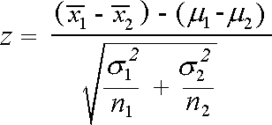
Two Sample Z Test
Equivalent to the t-test, the 2 data groups z-test examines two independent data sets
to determine whether or not the sample means of the two groups are identical.
H0: average of the two data groups is 0
H1: average of the two data groups is not 0
Formula for Two sample Z Test
Copyright © 2018 Pearson Education, Inc. All Rights Reserved.

Slide 22
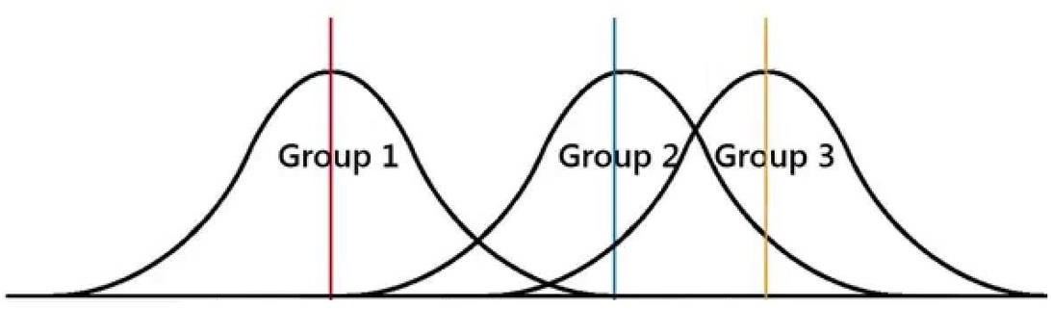
ANOVA - Analysis of Variance
Anova determines whether the means of three or more groups are different.
It uses F-Test to statistically test the equality of means.
The F-distribution cannot contain any negative numbers, contrary to the z-test and t-distributions, since the within and between-group variability are generally positive
due to squaring each deviation value.
Copyright © 2018 Pearson Education, Inc. All Rights Reserved.

Slide 23
Chi-Squared Test
The chi-squared test also known as χ² is used for testing for the relationship between
categorical variables.
T●here are two types of chi-squared test:
Goodness of fit test
chi-squared test of independence
Copyright © 2018 Pearson Education, Inc. All Rights Reserved.

Slide 24
Example: Titanic
The ship Titanic sank in 1912 with the loss of most of its passengers 809 of the 1,309 passengers and crew died = 61.8%
Research question: Did class (of travel) affect survival?
Copyright © 2018 Pearson Education, Inc. All Rights Reserved.

Slide 25


Chi squared Test?
Null: There is NO association between class and survival
Alternative: There IS an association between class and survival
Copyright © 2018 Pearson Education, Inc. All Rights Reserved.

Slide 26
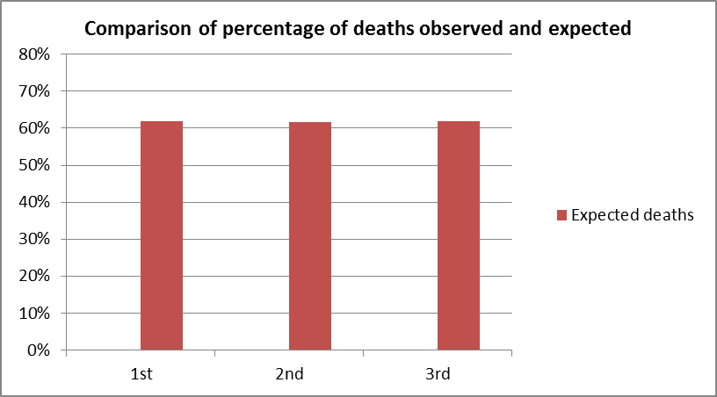
What would be expected if the null is true?
Same proportion of people would have died in each class! Overall, 809 people died out of 1309 = 61.8%
Copyright © 2018 Pearson Education, Inc. All Rights Reserved.

Slide 27
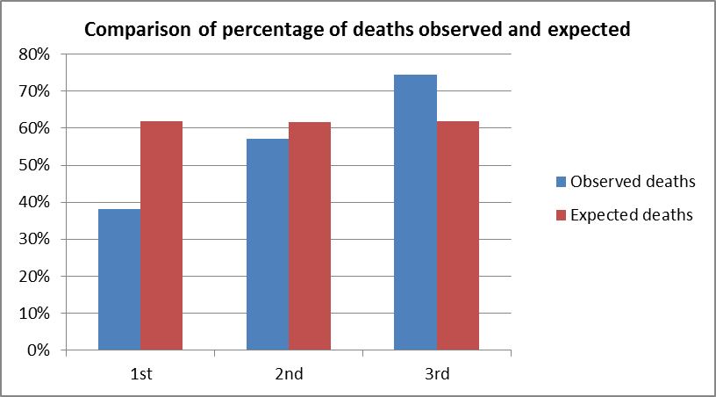
What would be expected if the null is true?
Same proportion of people would have died in each class! Overall, 809 people died out of 1309 = 61.8%
Copyright © 2018 Pearson Education, Inc. All Rights Reserved.

Slide 28
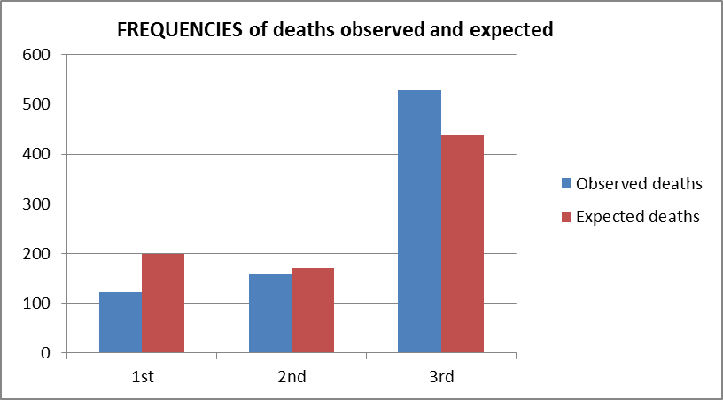
Chi-Squared Test Actually Compares Observed and Expected Frequencies
Expected number dying in each class = 0.618 * no. in class
Copyright © 2018 Pearson Education, Inc. All Rights Reserved.

Slide 29
Chi-squared test statistic
The chi-squared test is used when we want to see if two categorical variables are related
The test statistic for the Chi-squared test uses the sum of the squared differences between each pair of observed
(O) and expected values (E)
(O − E )
2
2 ₌
n
χ
∑
i i
E_{i}
i=1
Copyright © 2018 Pearson Education, Inc. All Rights Reserved.

Slide 30

Choosing the right test
A clearly defined research question
What is the dependent variable and what type of variable is it?
How many independent variables are there and what data
types are they?
Are you interested in comparing means or investigating
relationships?
Do you have repeated measurements of the same variable for each subject?
www.statstutor.ac.uk

Slide 31

Research question
Clear questions with measurable quantities
Which variables will help answer these questions
Think about what test is needed before carrying out a study so that the
right type of variables are collected
_{www.statstutor.a} Copyright © 2018 Pearson Education, Inc. All Rights Reserved.
c.uk

Slide 32
Dependent variables
INDEPENDENT
(explanatory/ predictor) variable
DEPENDENT
(outcome) variable
affects
Does attendance have an association with exam score? Do women do more housework than men?
www.statstutor.ac.uk

Slide 33
What variable type is the dependent?
Dependent
Scale
Categorical
Ordinal
Nominal
_{www.statstutor.a} Copyright © 2018 Pearson Education, Inc. All Rights Reserved.
c.uk

Slide 34

Data types
Research question | Dependent/ outcome variable | Independent/ explanatory variable
Does attendance have an association with exam score? | Exam score (scale) | Attendance (Scale)
Do women do more housework than men? | Hours of housework per week (Scale) | Gender (binary)
www.statstutor.ac.uk

Slide 35


Exercise: Solution
How would you investigate the fo:llowing topics? State the
dependent and independent variables and their variable types.
Research question | Dependent/ outcome variable | Independent/ explanatory variable
Were Americans more likely to survive on board the Titanic? | Survival (Binary) | Nationality (Nominal)
Does weekly hours of work influence the amount of time spent on housework? | Hours of housework (Scale) | Hours of work (Scale)
Which of 3 diets is best for losing weight? | Weight lost on diet (Scale) | Diet (Nominal)
www.statstutor.ac.uk

